Slide 1



Aurecon graduate campaign 2020

Slide 2
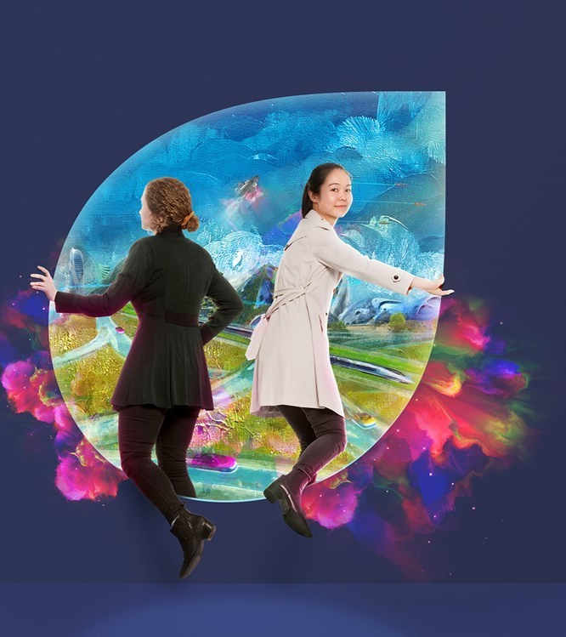
Overview
Generation Z have entered the workforce and they are bold. They are not hesitant to step forward and do what it takes to design a better future for the next generation.
Furthermore, they value employers who provide them with flexibility, choice, and freedom to be themselves.
Aurecon used its reputation as a future ready employer in these areas –along with its eminence in projects, digital, and innovation to differentiate itself from the competition and create the ‘Unconventional graduate campaign’.
The campaign was supported by a broad range of Aurecon’s graduates, each aligned with an unconventional story to tell about how they are making an impact in their role and creating a better world.
The following slides show the elements of the campaign:

Slide 3
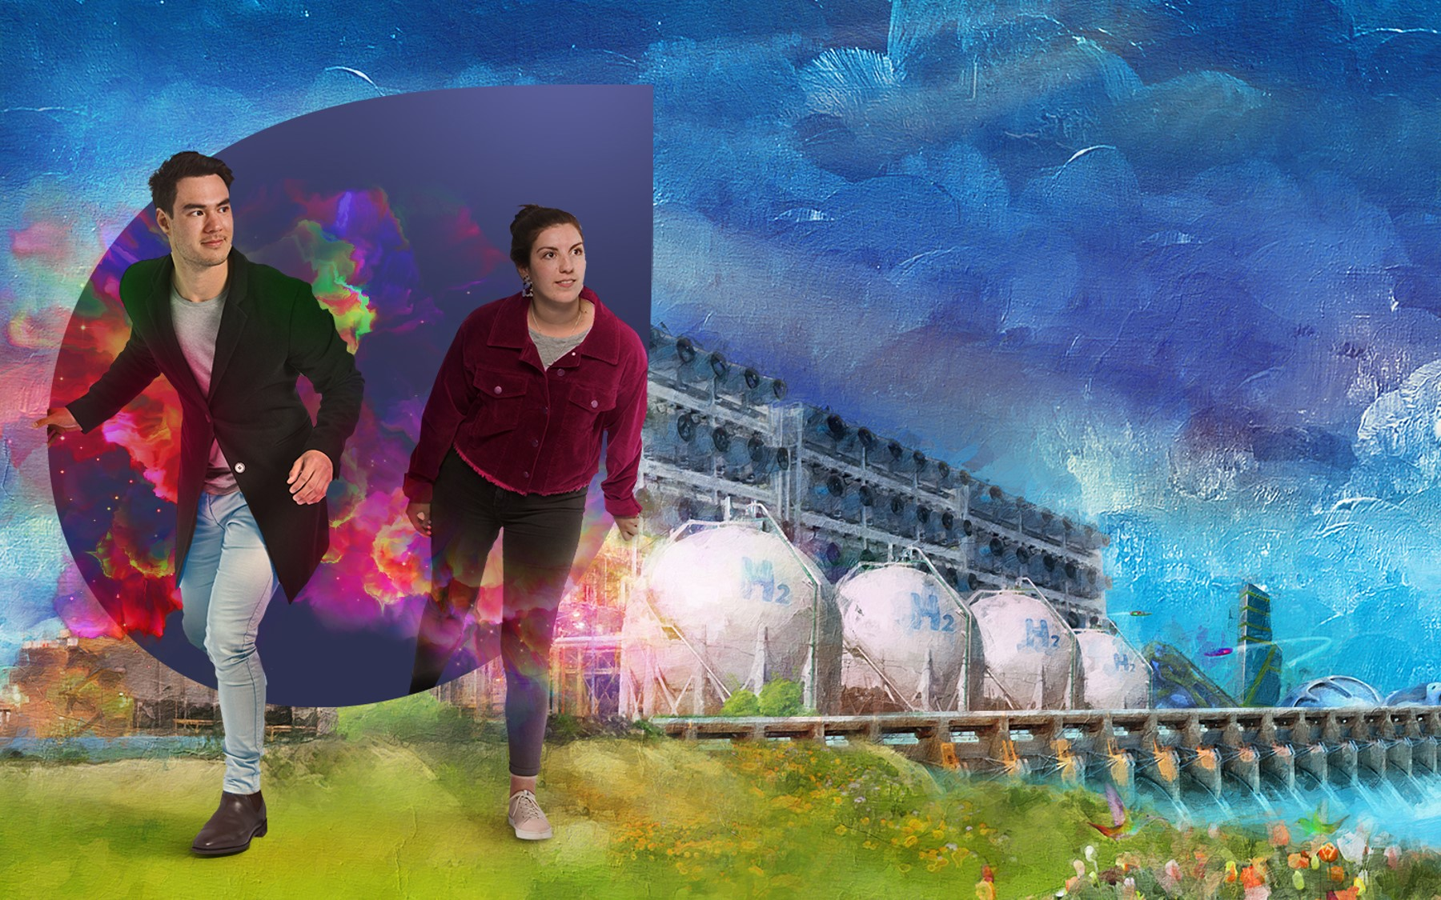
Career fair materials

Slide 4
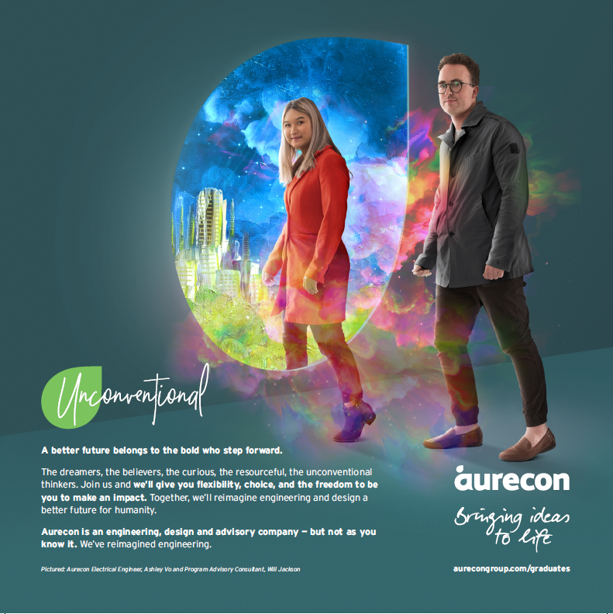
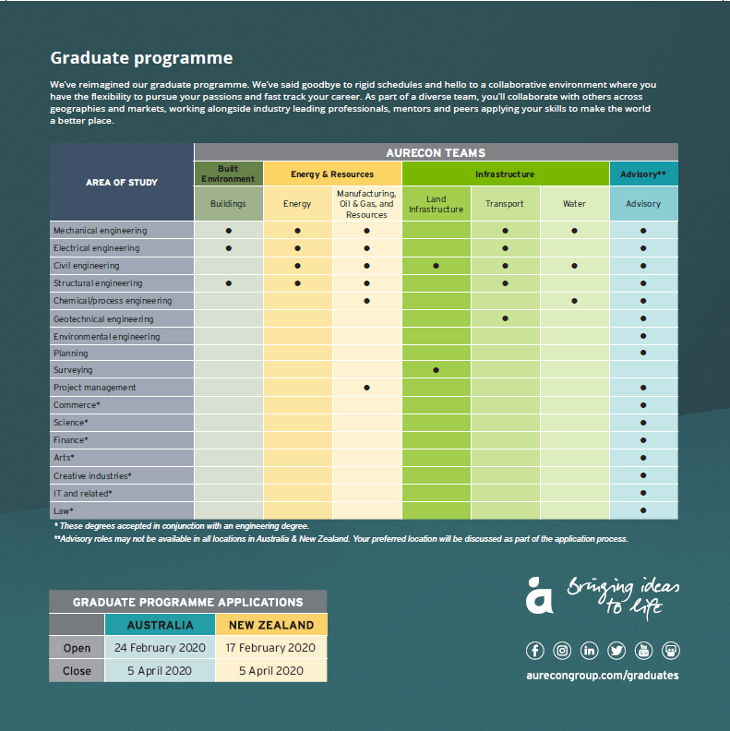
Career fair materials
A direct marketing card about the graduate programme was used at career fairs to promote our key messages.
Front and back of graduate programme card

Slide 5
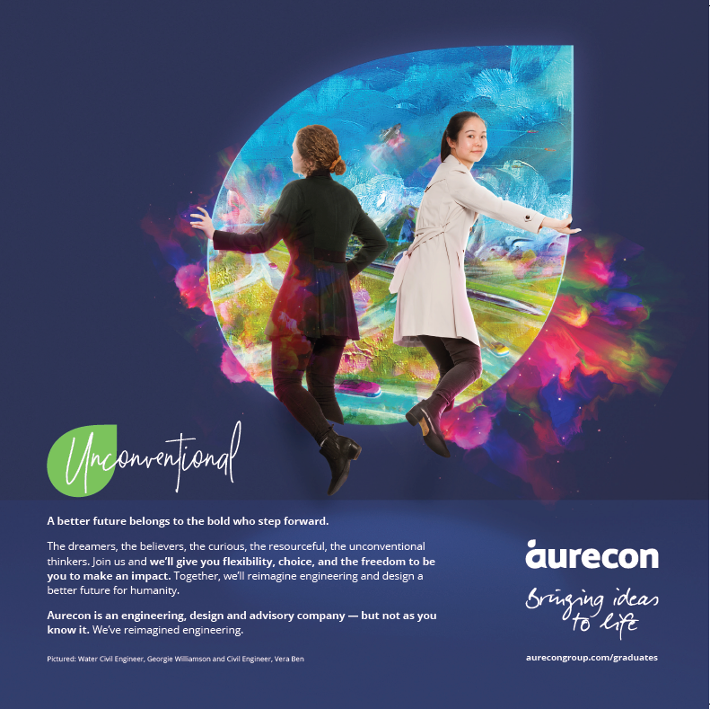
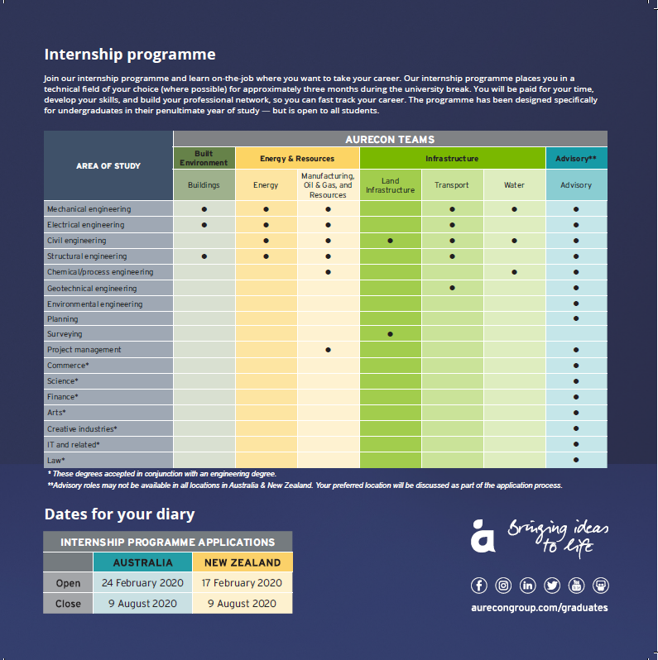
Career fair materials
A direct marketing card about the internship programme was used at career fairs to promote our key messages.
Front and back of internship programme card

Slide 6

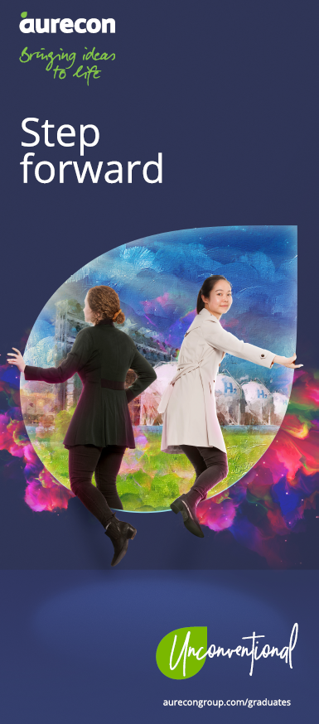
Career fair materials
Banners further supported the campaign by showcasing different ‘future worlds’ for graduates to step into.
Each state chose a supporting banner to highlight the area of higher recruitment need e.g. Queensland had the renewable resources banner. See more on next slide
Main banner
Supporting localised banner

Slide 7

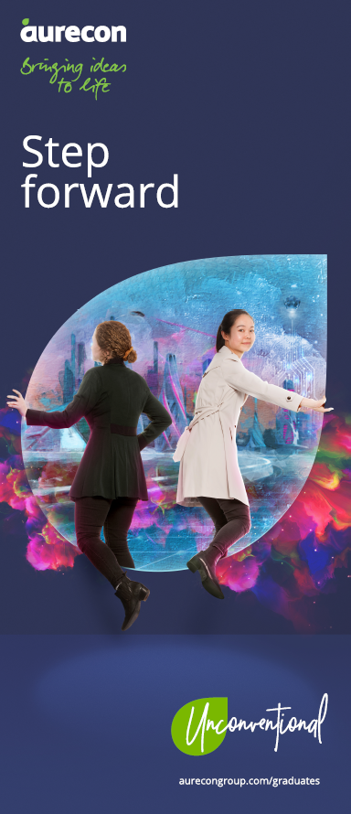
Career fair materials
Banners further supported the campaign by showcasing different ‘worlds’ for graduates to step into.
We attended all major career fairs until the COVID-19 outbreak.
Main banner
Other supporting banners

Slide 8
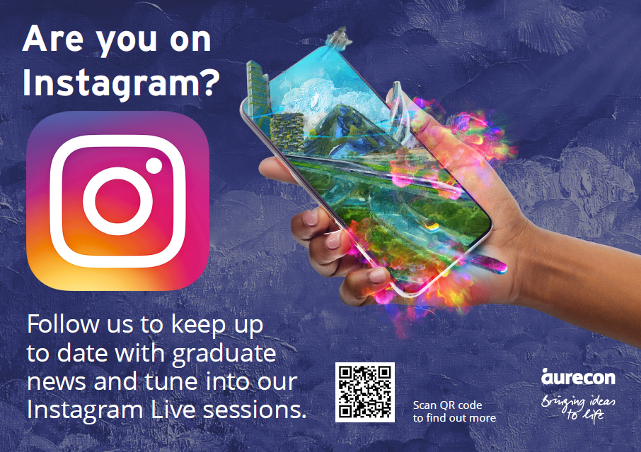
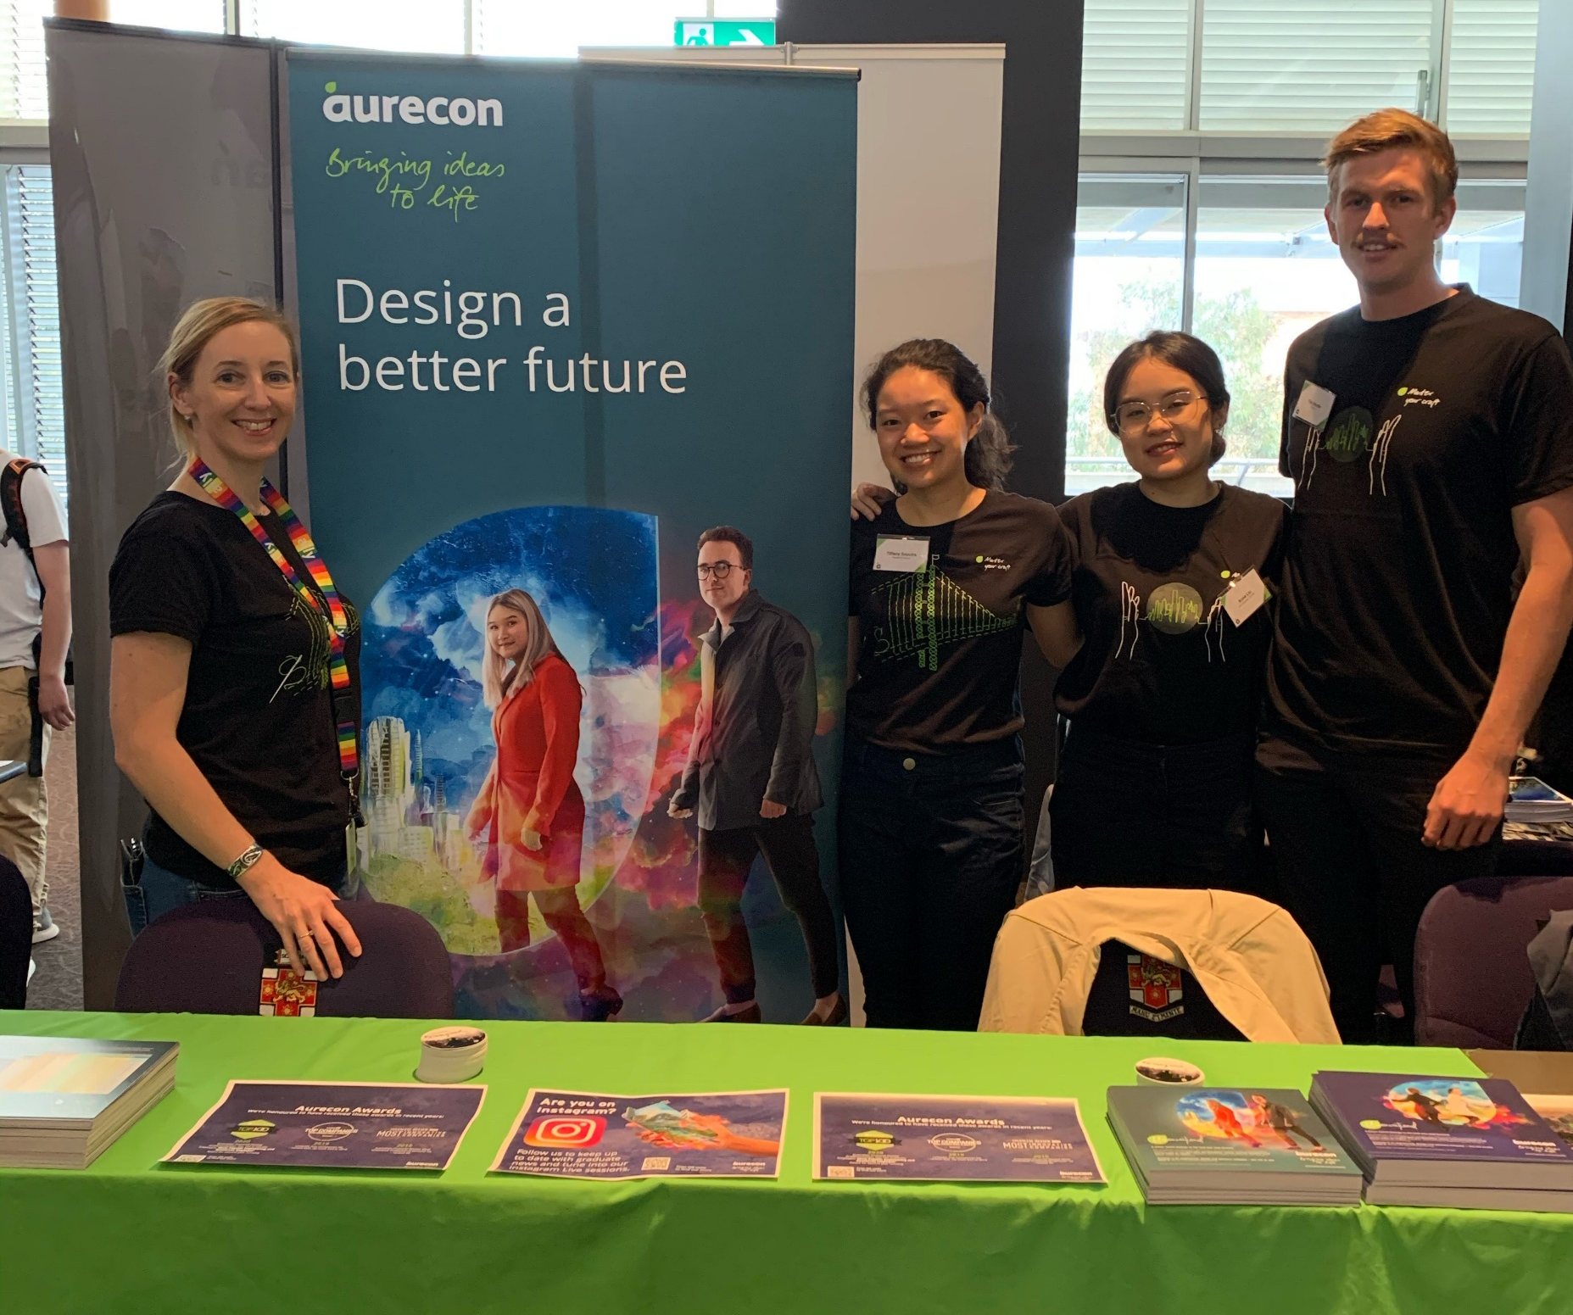
Career fair materials
Posters encouraging graduates to follow us on Instagram for our live sessions were displayed.
Instagram poster
Typical career fair display

Slide 9
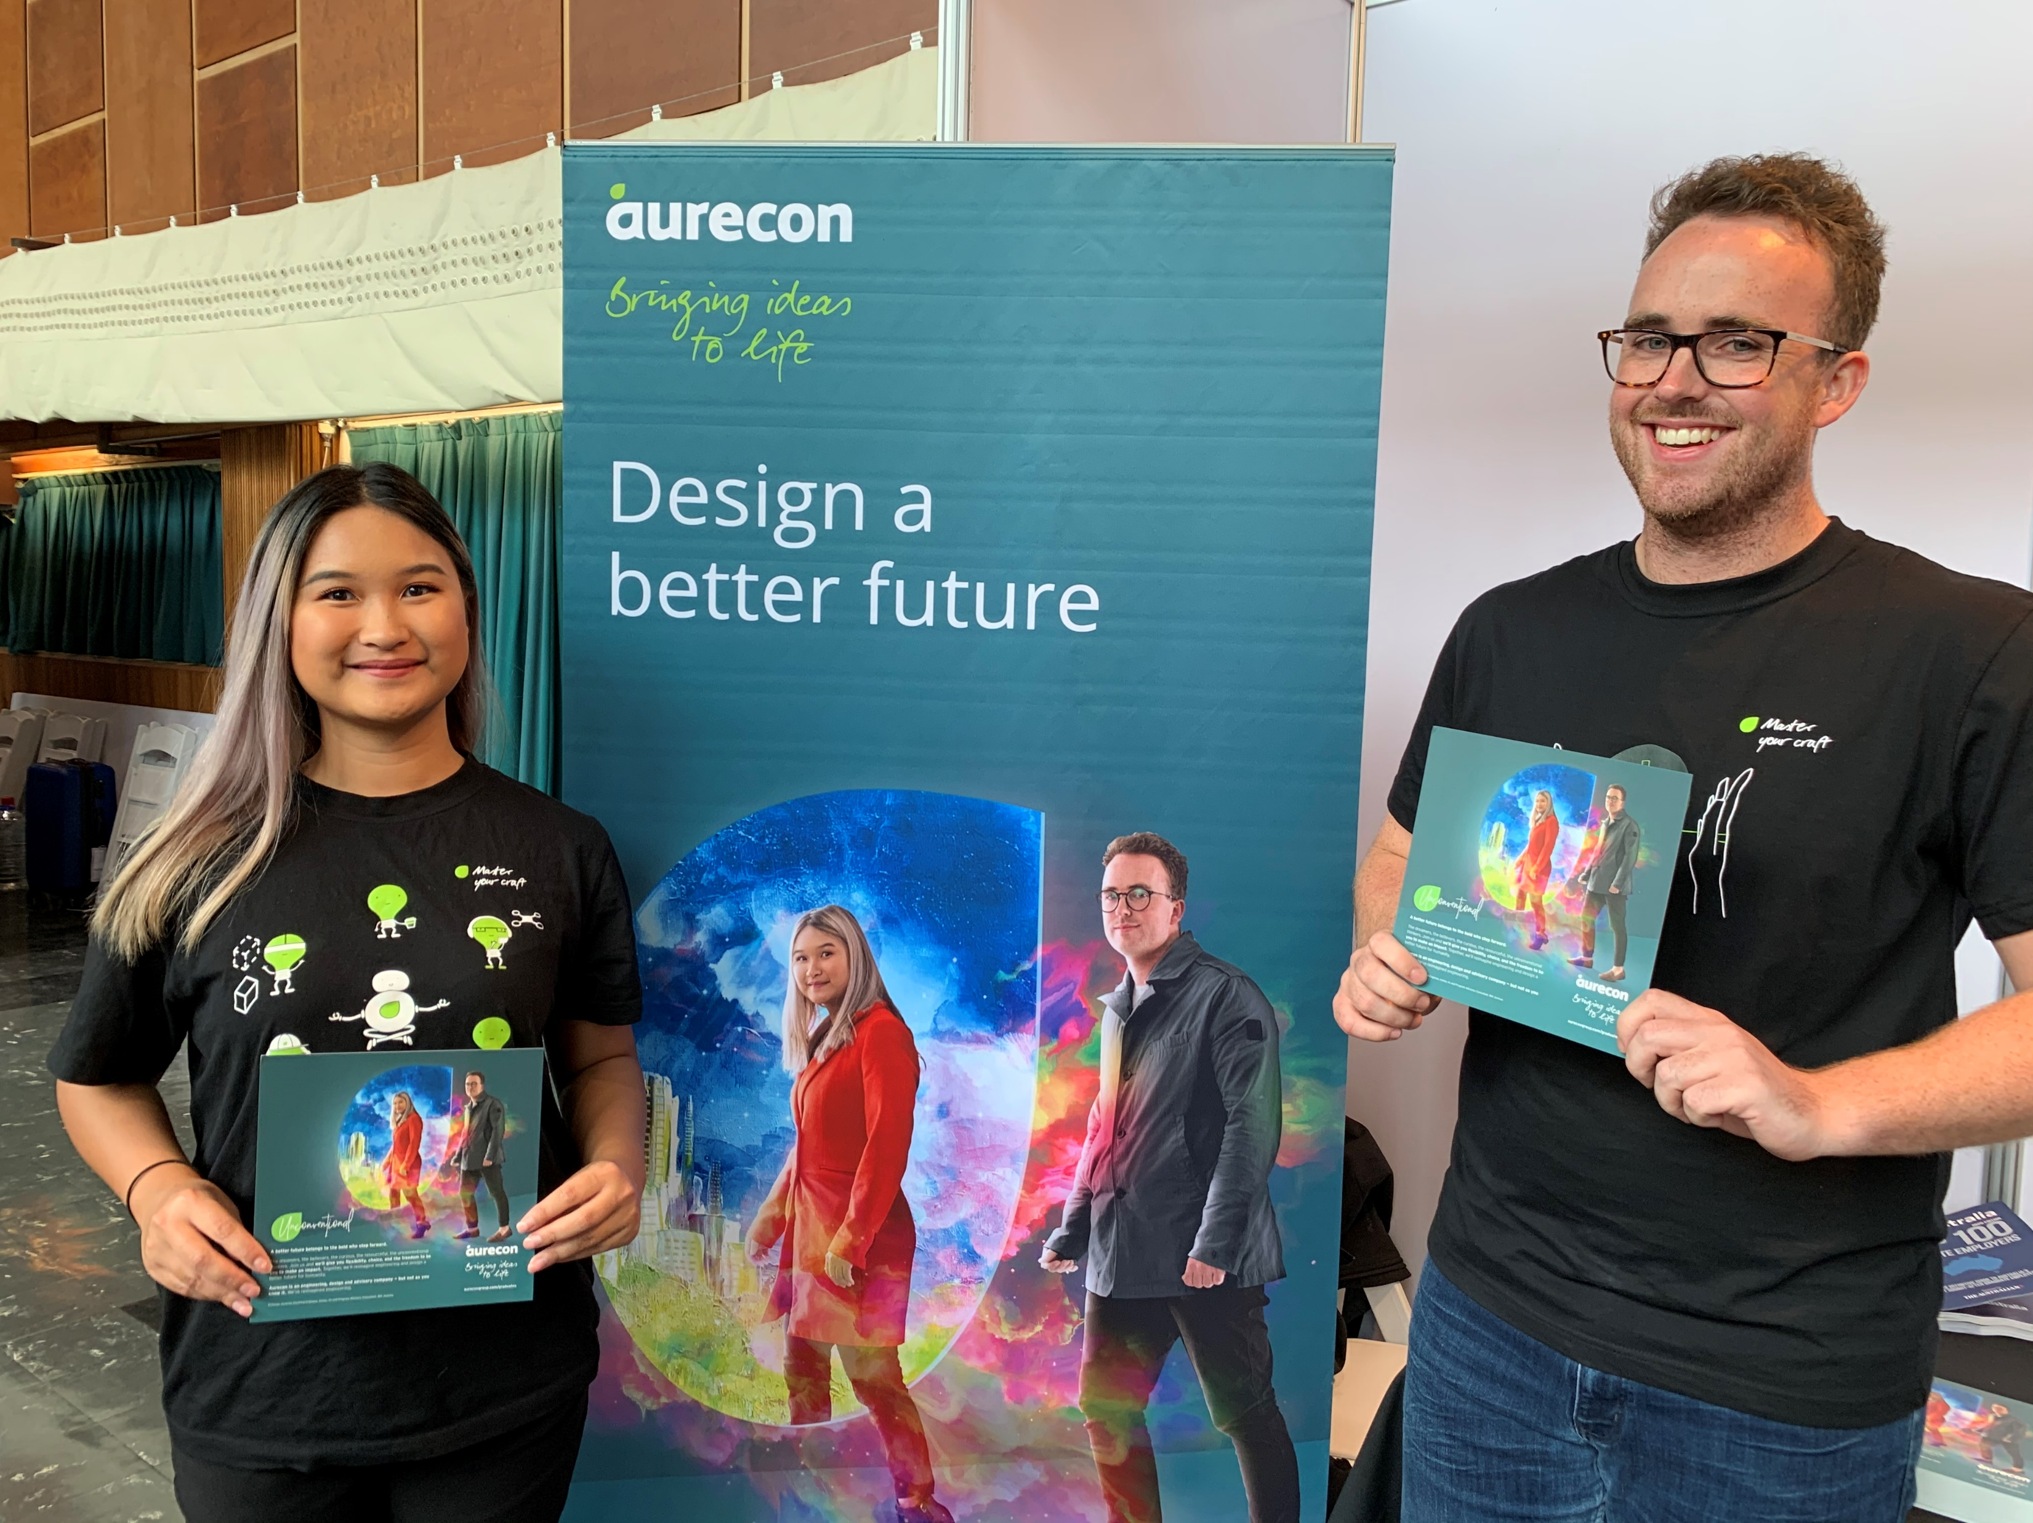
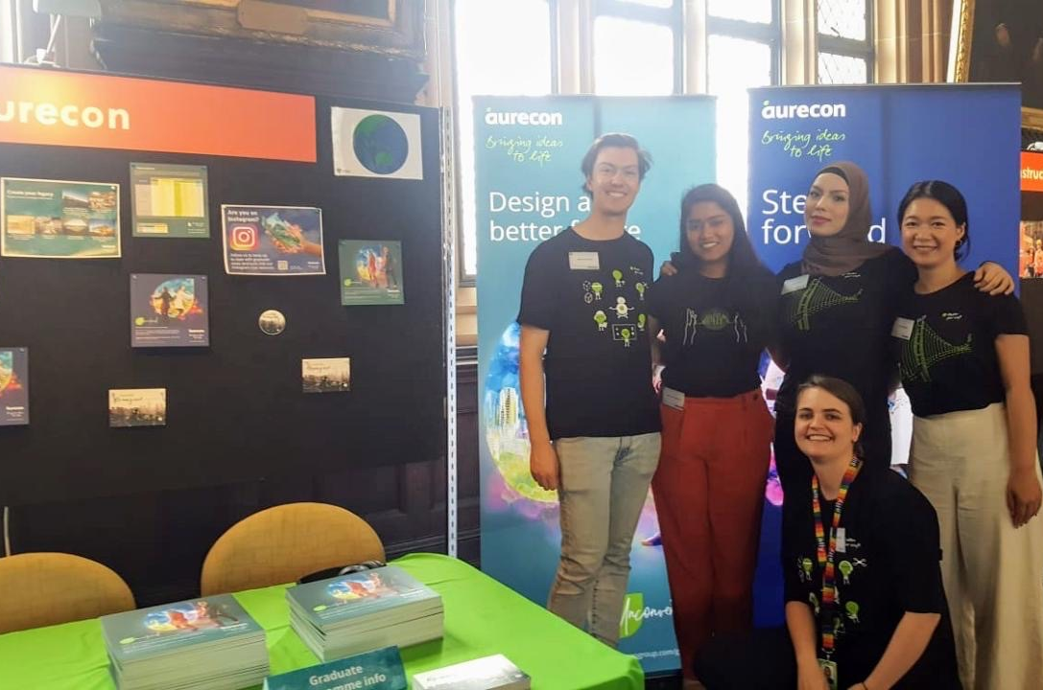
Career fair materials
Graduates used on campaign materials attended the career fairs to support the authenticity of our brand.
Aurecon team at career fairs

Slide 10

Social media
Social media

Slide 11
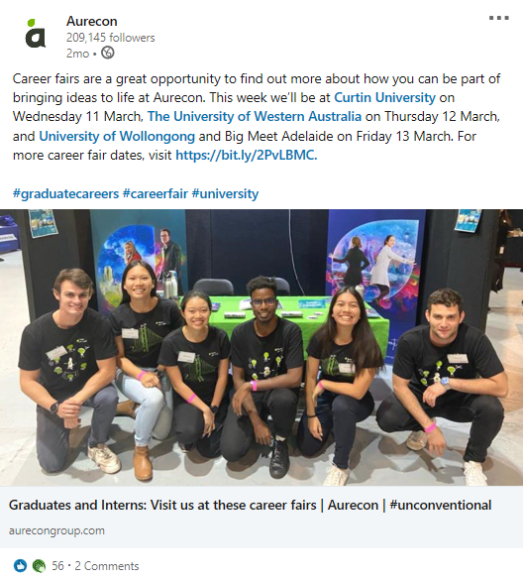
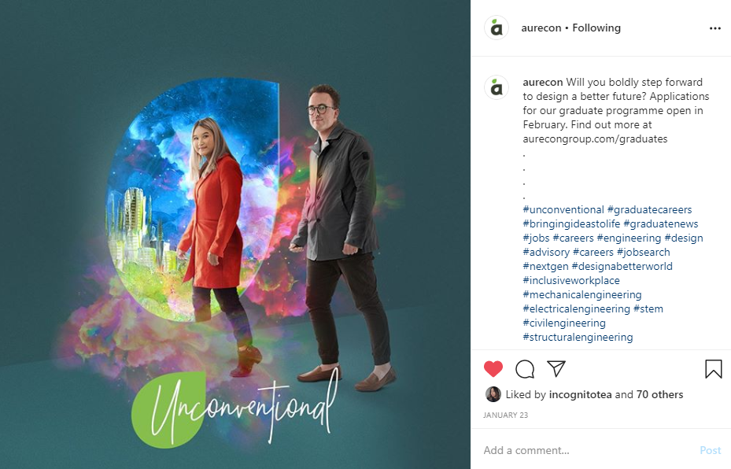
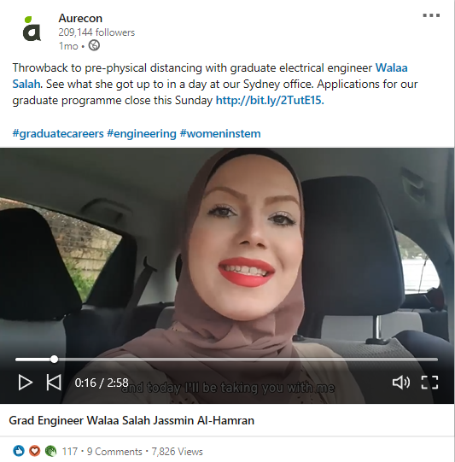
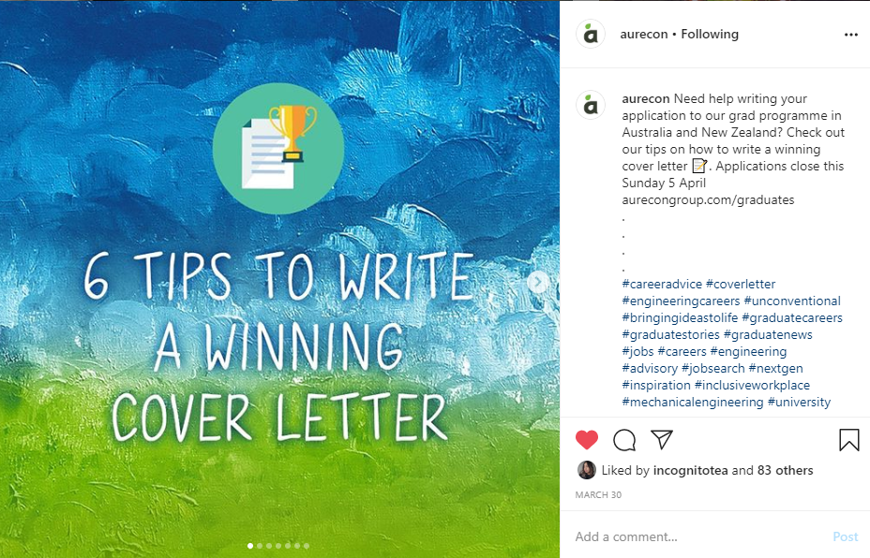
Social media posts
A considered social media plan for LinkedIn, Facebook, Instagram and Twitter was developed to communicate important, relevant content.
Key messages and imagery of the campaign were reiterated through our social media posts through videos of our graduates, evergreen content, and reminders of important dates.
Social media posts

Slide 12
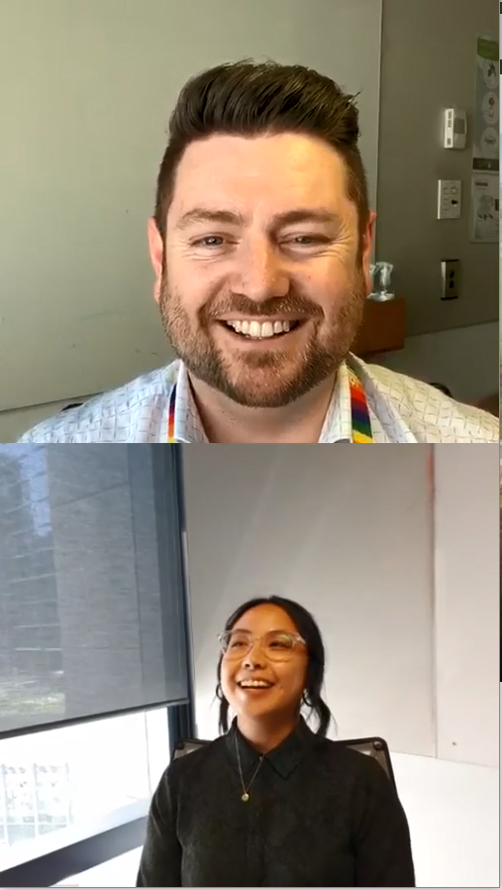
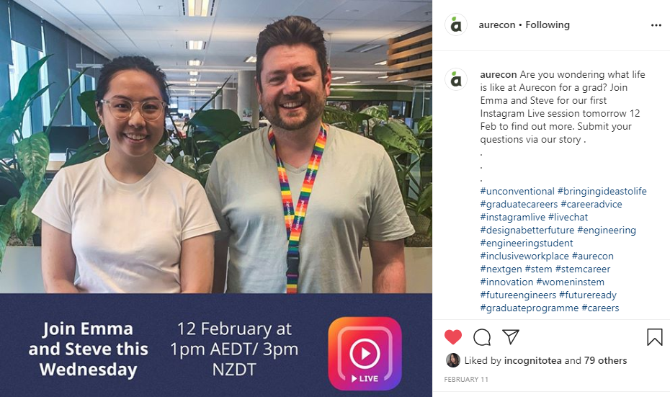
Instagram live
Instagram was a key social media platform for the campaign, given its popularity with Generation Z graduates.
Four Instagram Live sessions were held covering key messages and useful information graduates value at various stages of the recruitment period. e.g. comparing employers, going to career fairs etc.
Instagram Live view
Social media promotion

Slide 13
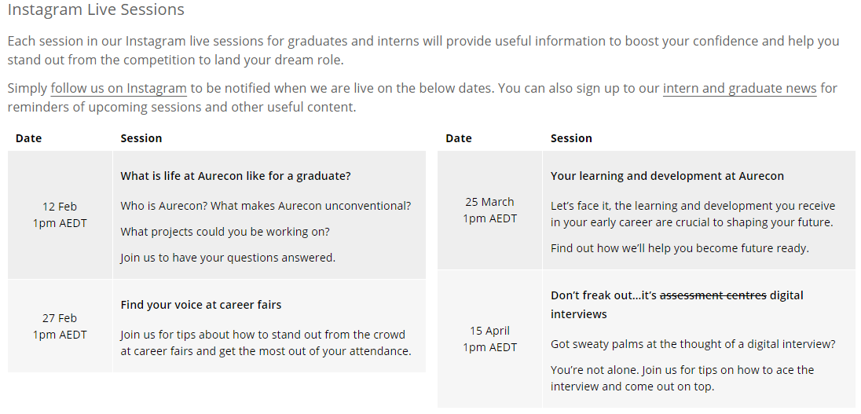
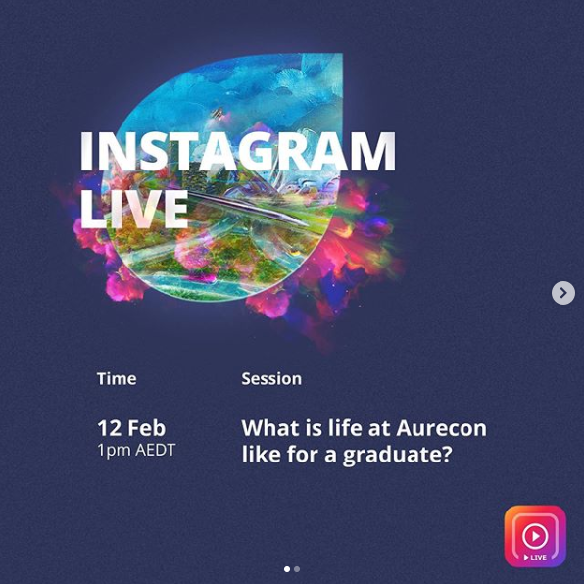
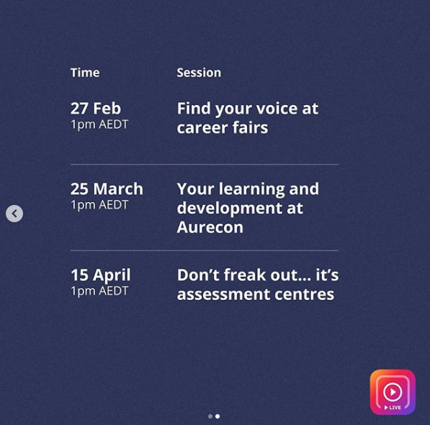
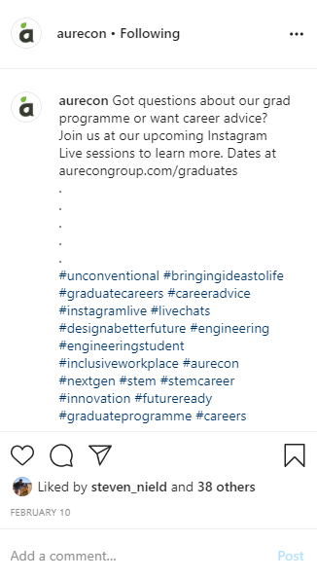
Instagram live
Each session received on average 800 unique views within 24 hours of going live.
Over the campaign period Aurecon also achieved 1135 new followers on Instagram.
Instagram Live topics displayed on the Aurecon website
Instagram Live topics outlined on social channels

Slide 14
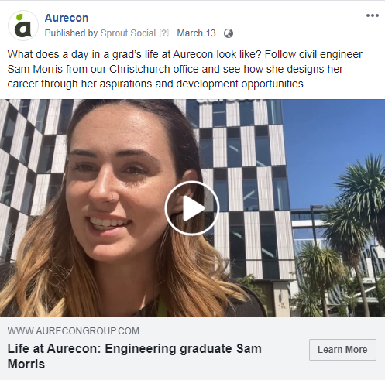
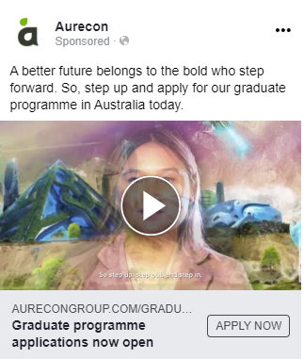

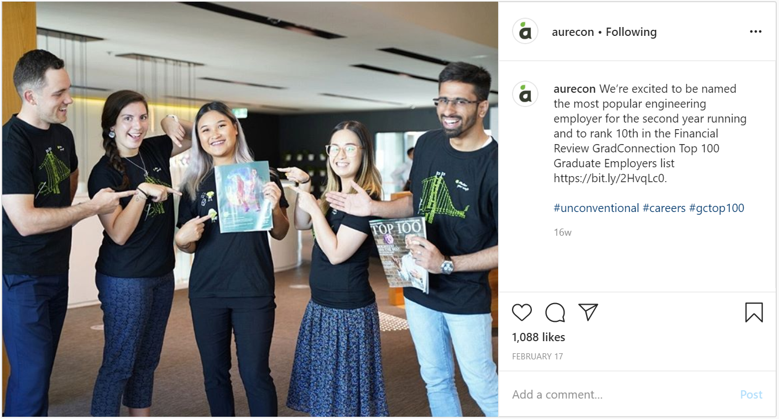
Social media advertising
Boosted posts were actioned across Instagram, Facebook and Facebook Messenger. Each post communicated our campaign imagery and key messages.
Boosted social media posts

Slide 15
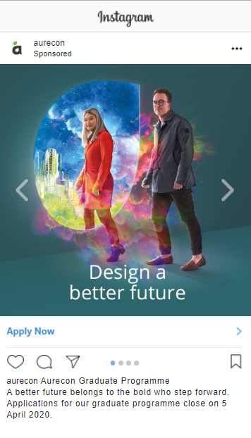
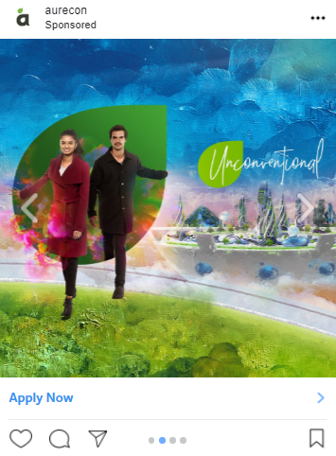
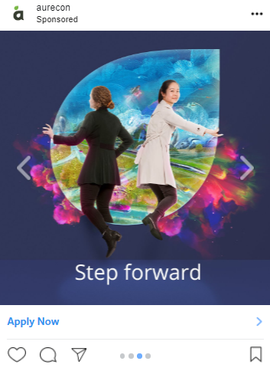
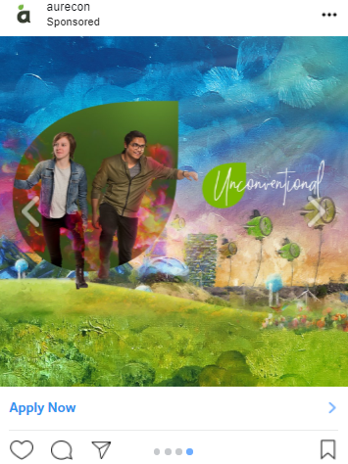
Social media advertising
Targeted carousel advertisement used during the campaign on Facebook, Facebook Messenger and Instagram. The ad appeared in the social media feed of graduates.
Carousel ad

Slide 16
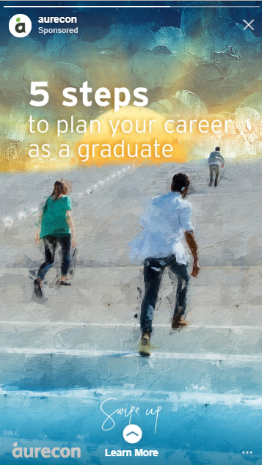
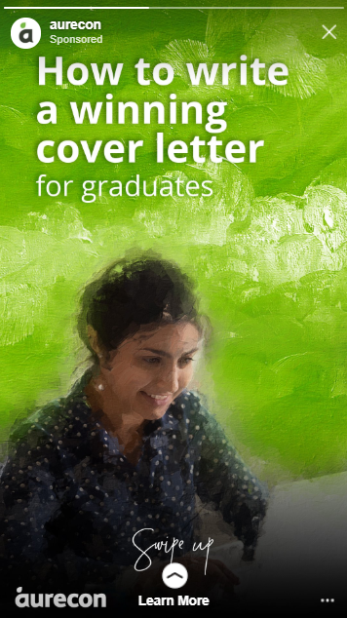
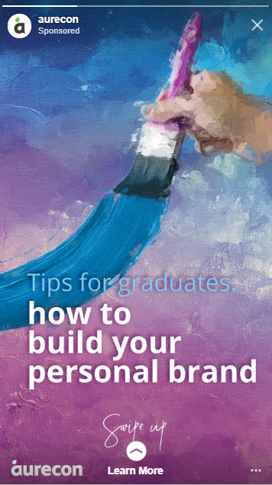
Social media advertising
Targeted story ads were created around useful content that graduates would be interested in.
Each post was linked directly back to our website.
Evergreen content story ads

Slide 17
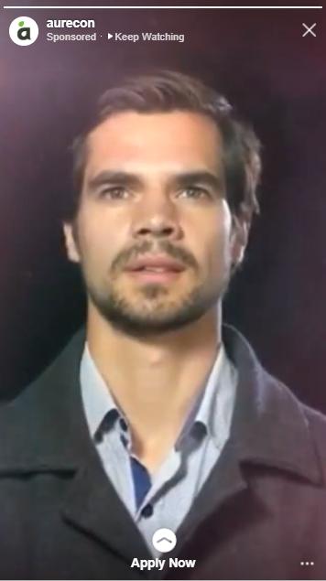
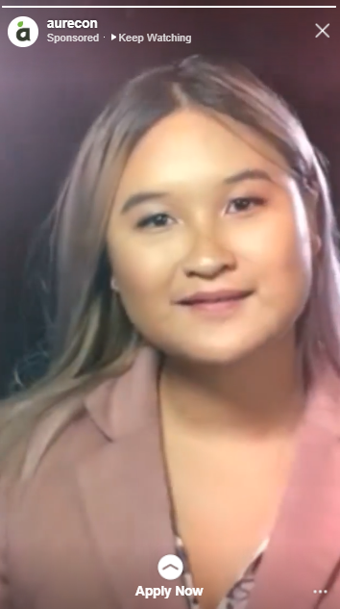
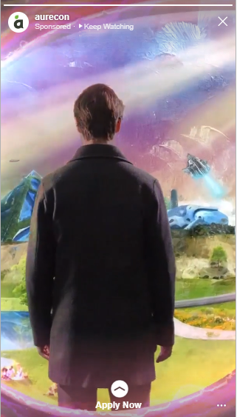
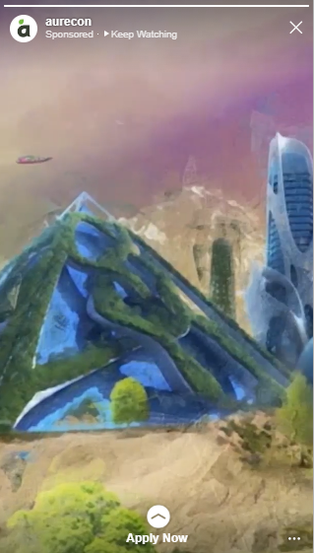
Social media advertising
Targeted story ads were also created using the main campaign video. The ads were used on Facebook, Instagram, and Facebook Messenger.
Each post was linked directly back to our website.
Campaign video story ads

Slide 18

Electronic direct mail
Electronic direct mail

Slide 19
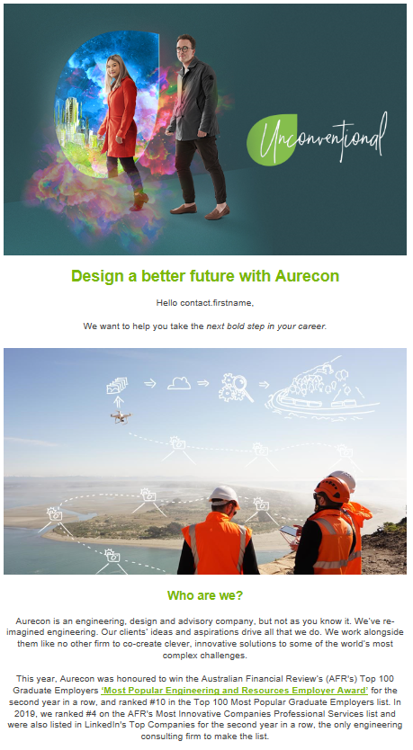
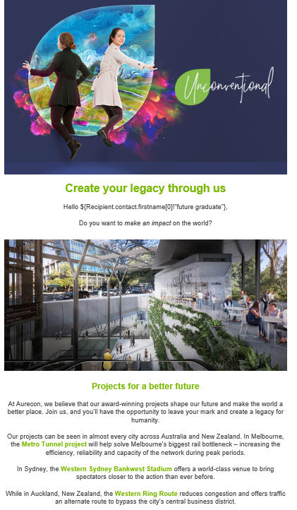
Direct emails
A series of seven targeted electronic direct mails (eDMs) were sent to subscribers of Aurecon’s graduate news. The same series was distributed by third party graduate recruitment websites such as GradConnection.
The eDM series focused on communicating our campaign imagery and providing proof points around our key messages.
eDM 1
eDM 2

Slide 20
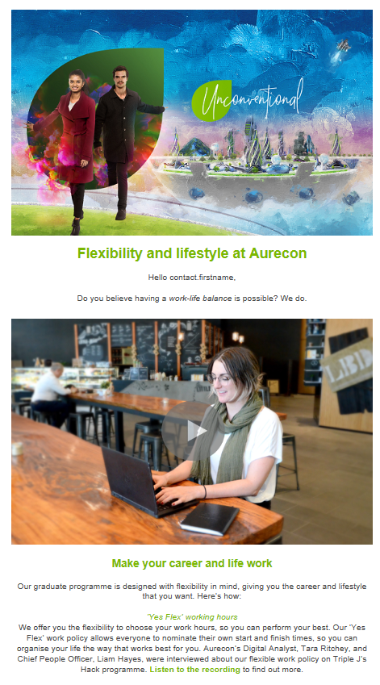
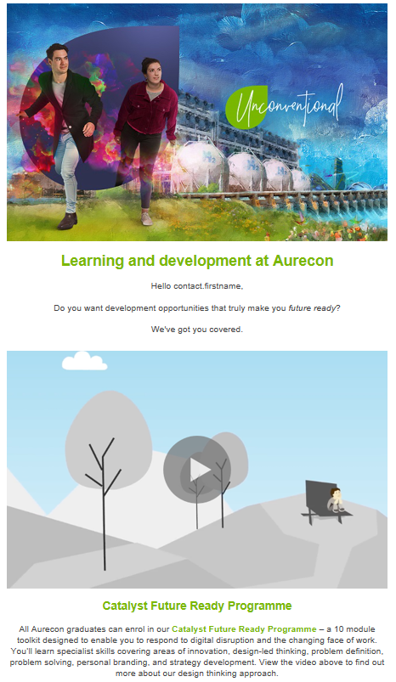
Direct emails
The average open rate for eDMs across the campaign was 48%, well above industry average *
*Average open rate attributed from Mail Chimp industry benchmarks https://mailchimp.com/resources/email-marketing-benchmarks/
eDM 3
eDM 4

Slide 21
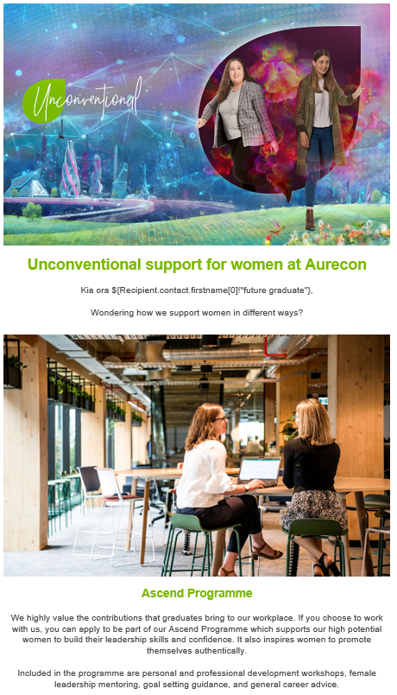
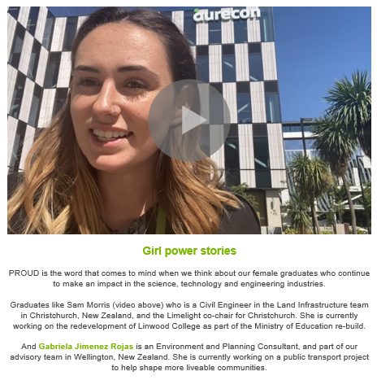
Direct emails
Continued…
eDM 5
eDM 5 continued

Slide 22
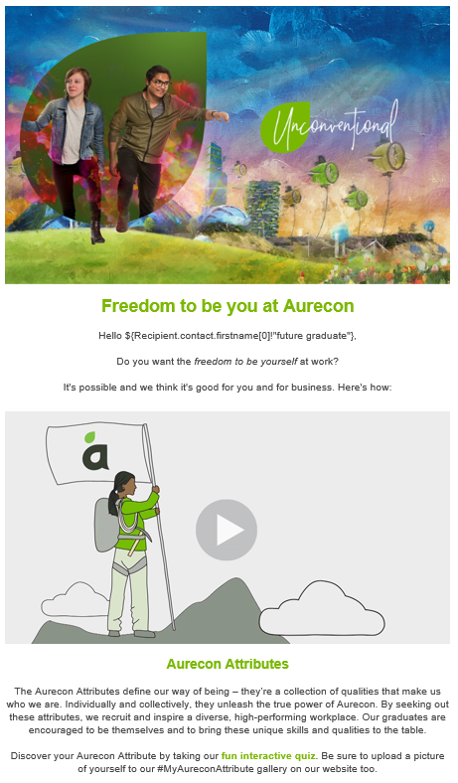
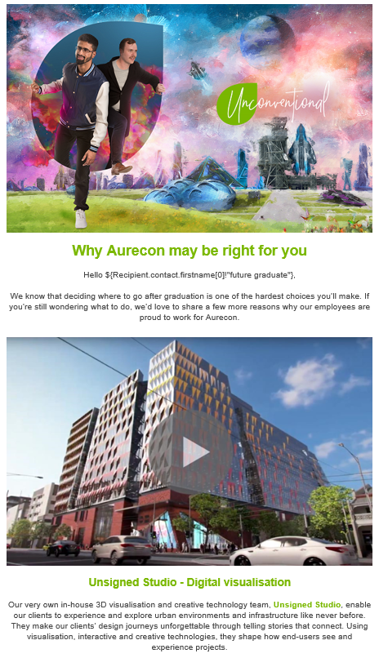
Direct emails
Continued…
eDM 6
eDM 7

Slide 23
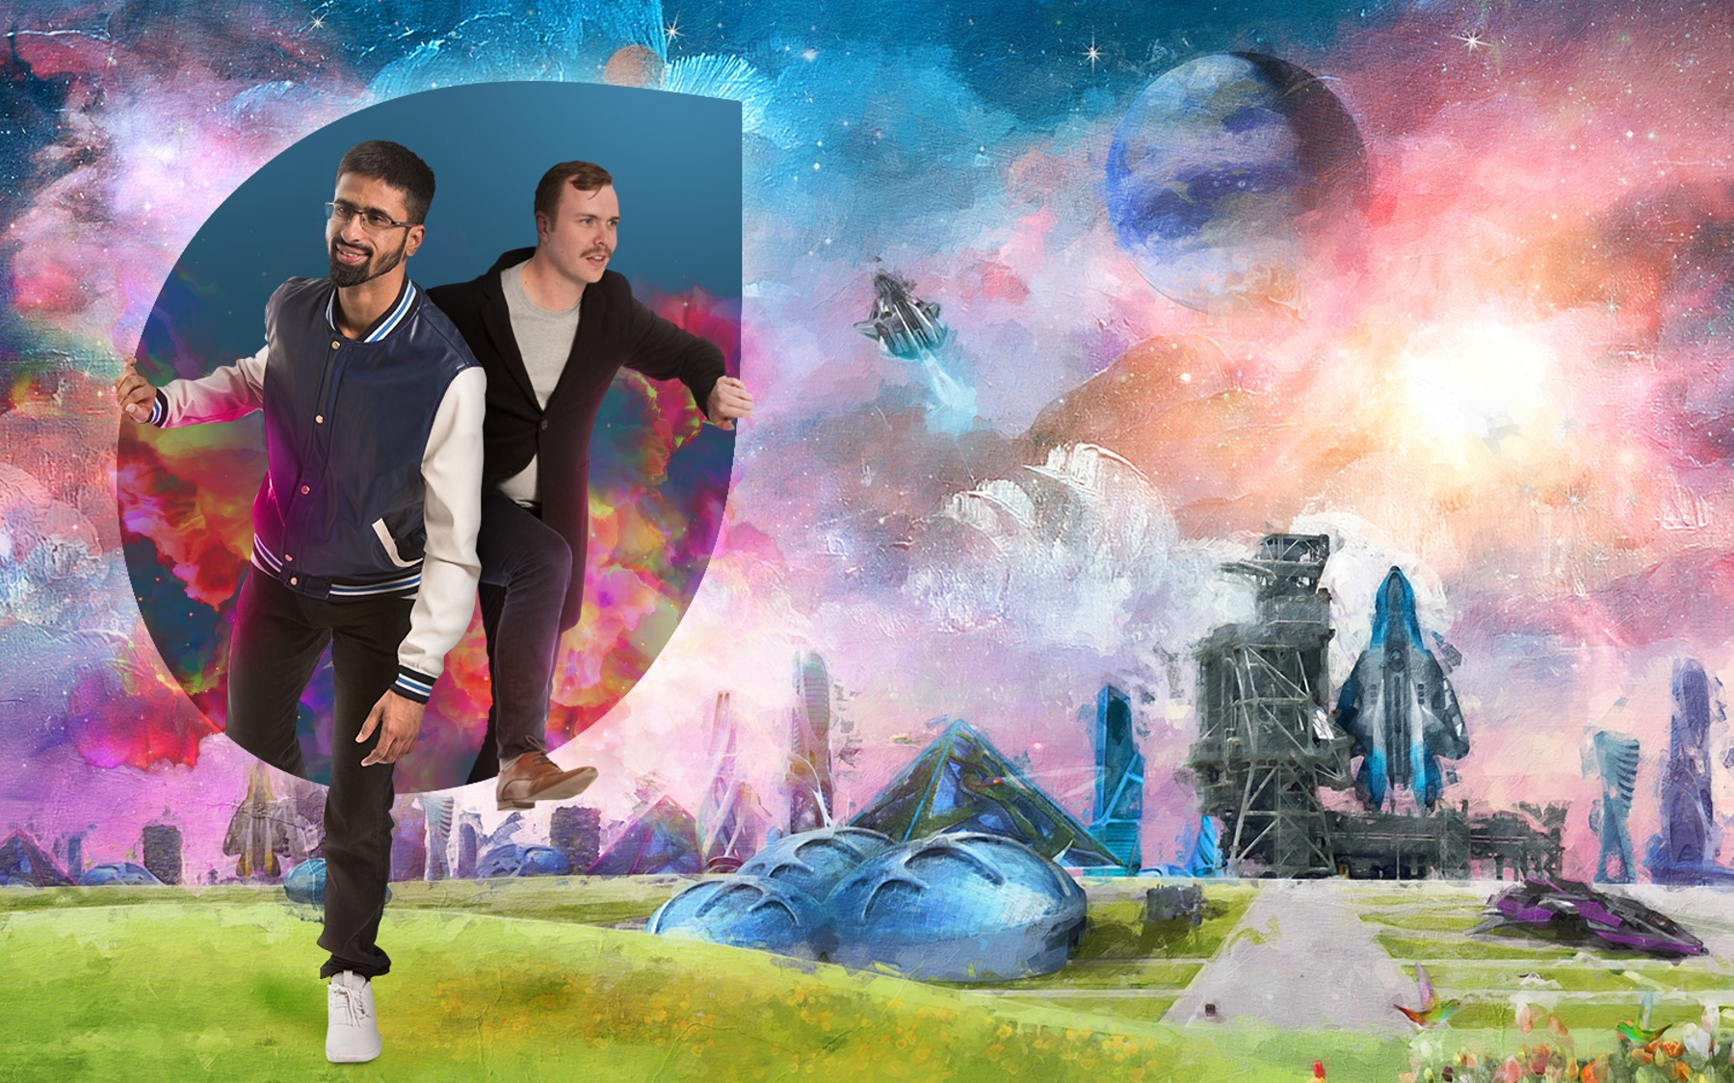
Website

Slide 24
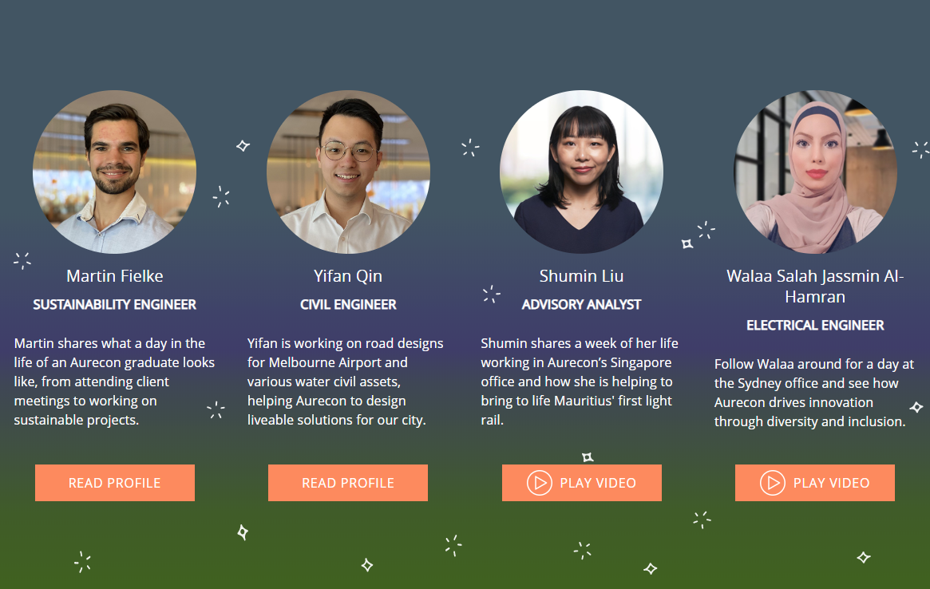
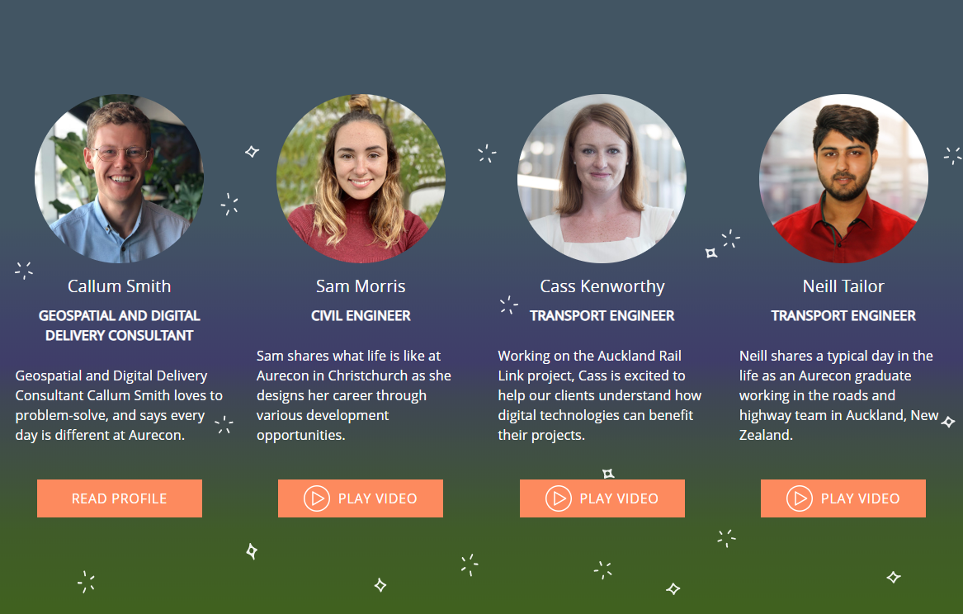
Graduate videos and profiles
Aurecon’s project team also engaged students through a series of ‘day in the life’ graduate videos and written profiles that were featured on our graduate webpage.
These profiles highlighted an authentic experience of a graduate, while also highlighting our key messages.
Graduate videos and profiles on our website

Slide 25
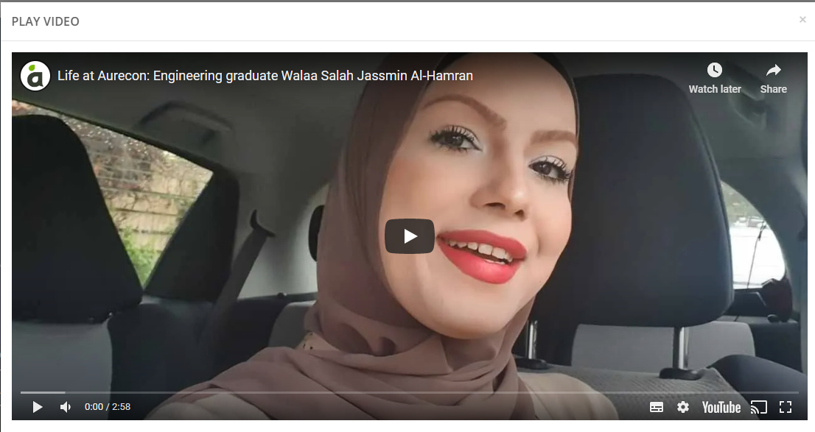
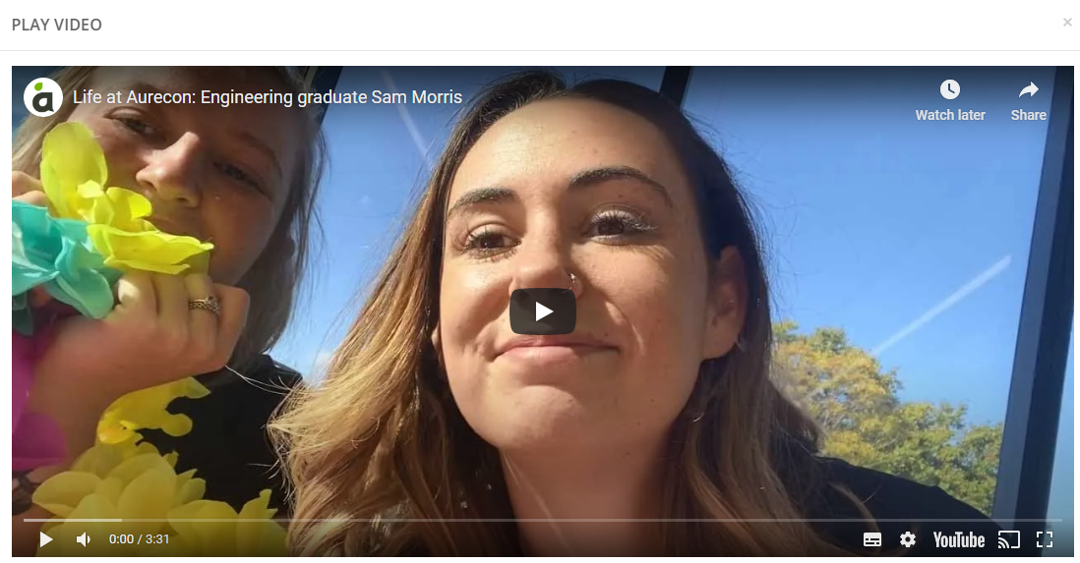
Graduate ‘day in the life’ videos
This series of ‘day in the life’ graduate videos are linked to their profiles on the website, and were also shared on social media throughout the campaign period.
The videos shared more information about how they are designing a better future.
Graduate video pop-outs

Slide 26
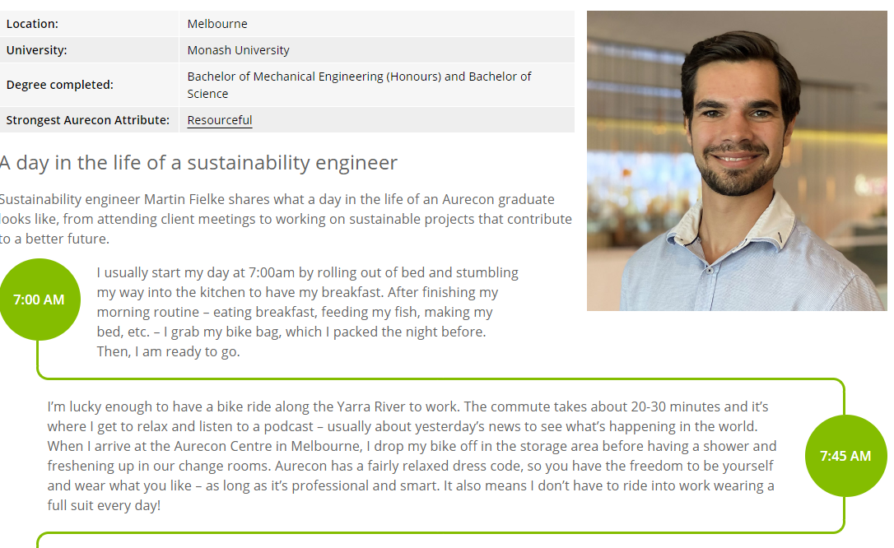


Graduate profiles
These profiles highlighted an authentic experience of a graduate, while also highlighting key messages such as flexibility, freedom to be you, making an impact and designing a better future.
The profiles featured on the website, and were also shared on social media throughout the campaign period.
Graduate profile shared on social
Graduate profile on website

Slide 27


Campaign video
The main campaign video is also watchable on our website through our banner.
Main campaign video pop-out

Slide 28




Campaign video
The main campaign video is an extension of the campaign image and message.
Screenshots of the campaign video

Slide 29


News article and AFR feature
News article published on our website to celebrate the win of “Most Popular Engineering and Resources Employer” featured in the Australian Financial Review’s Top 100 Graduate Employers Guide 2020.
News article
Physical copy of the ad in the Top 100

Slide 30




AFR ad and feature
Advertisement featured in the Australian Financial Review’s Top 100 Graduate Employers Guide 2020
Ad and article in Australian Financial Review, Top 100 Graduate Employers Guide 2020

